Slide 1


Java ee
(ADVANCE JAVA)
Lecture-37

Slide 2

Today’s Agenda
What Is DOM ?
DOM Properties
DOM Methods

Slide 3
DOM Introduction
Javascript is mostly used to provide a means for our visitors to interact with our web page.
In order to be able to do this we need to have some means by which our JavaScript program can access the component parts of the web page.
This is done using DOM ( Document Object Model)

Slide 4
What Is DOM ?
When a Web browser loads an HTML file, it displays the contents of that file on the screen.
But that’s not all the Web browser does with the tags, attributes, and contents of the file: it also creates and memorizes a “model” of that page’s HTML.
In other words, the Web browser remembers the HTML tags, their attributes, and the order in which they appear in the file—this representation of the page is called the Document Object Model, or DOM in short

Slide 5
Example(Human View)
<html>
<head>
<title>An Example XHTML Document</title>
<link rel="stylesheet" href="style.css" type="text/css" />
</head>
<body>
<p>This is an example paragraph.</p>
<p>This is an example paragraph with
<a href="stuff.html">a hyperlink</a> inside of it!</p>
<p>And here's one with<br />a line break
and an <img src="image.jpg" alt="image">.</p>
</body>
</html>

Slide 6
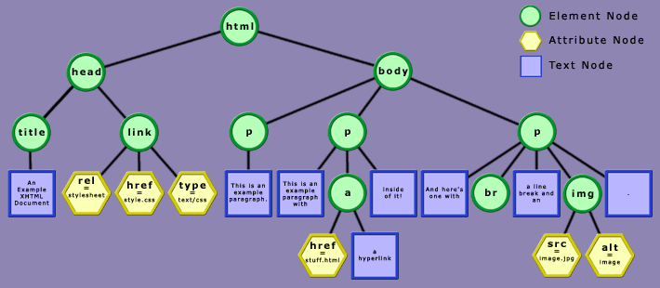
Browser View

Slide 7
Explanation
In the HTML DOM, everything is a node.
The entire document is a document node
Every HTML element is an element node
The text inside HTML elements are text nodes
Every HTML attribute is an attribute node

Slide 8
What Can Be Done With DOM ?
With DOM , a programmer gets all the power he needs to create dynamic HTML:
Using DOM we can can change all the HTML elements in the page
Using DOM we can can change all the HTML attributes in the page
Using DOM we can can change all the CSS styles in the page
Using DOM we can can react to all the events in the page

Slide 9
DOM Properties
1. childNodes
Returns an array of all the children of the specified node.
2. firstChild
Returns the first child node
3. lastChild
Returns the last child node

Slide 10
DOM Properties
4. nextSibling
Returns the node immediately following the specified node.
5. previousSibling
Returns the node immediately preceding the specified node.
6. parentNode
Returns the parent node of the specified node

Slide 11
DOM Properties
7. nodeName
Returns the name of the node. If the node is an element it returns the tag name of the node and if the node is a text it returns “#text”.
8. nodeValue
Returns the value of the node . If it is text node then the actual text is returned and if it is an element then null is returned.

Slide 12
DOM Properties
9. innerHTML
Sets or retrieves the HTML between the start and end tags of the object.

Slide 13
DOM Properties DrawBacks
Although we can select html elements using DOM properties but this approach is very difficult to maintain because:
a. Any change in the page’s HTML code would require to change our DOM coding
b. Many properties have different behaviors in different browsers.
Thus a better approach is to use DOM selection methods

Slide 14
DOM Selection Methods
Selection of elements can be done by 3 methods:
1. getElementById( idvalue)
This method selects and returns only that element whose id value matches with the string passed as argument.
Example:
var x=document.getElementById(“p1”);

Slide 15
DOM Selection Methods
2. getElementsByTagName( tag name)
This method selects and returns an array of those HTML elements whose tag matches with the string passed as argument.
Example:
var x; x=document.getElementsByTagName(“p”);

Slide 16
DOM Selection Methods
3. getElementsByClassName( class name)
This method selects and returns an array of those HTML elements whose class name matches with the string passed as argument.
Example:
var x; x=document.getElementsByClassName(“cl”);

Slide 17
Setting/Getting Text Node Value
To set/get a text node’s value we can use the following approach:
1. Obtain reference to it’s parent node.
2. Access the text node by using “firstChild” or “childNodes[0]”
3. Finally set/get it’s contents using “nodeValue”

Slide 18
DOM Modification Methods
Modifying the HTML DOM can be many different things
Changing HTML content
Changing CSS styles
Creating new HTML elements
Removing existent HTML elements

Slide 19
Changing HTML
To change an elements HTML content we need to do the following:
1. Obtain a reference to the element.
2. Use it’s innerHTML property to change it’s HTML effect

Slide 20
Changing CSS
To change an elements CSS style we need to do the following:
Obtain a reference to the element.
Use it’s style property to gain access to it’s CSS coding.
style property itself has child properties for specific styles. Like:
backgroundColor
color
borderColor
fontFamily
fontWeight : bold,bolder,lighter,normal,100to 900
fontStyle: normal,italic,oblique

Slide 21
Creating New Element
To create new HTML elements we use 3 steps:
1. Create a new element with createElement( ).
2. Create a new text node using createTextNode() method.
3. Add the element to it’s container using appendChild( ) method.

Slide 22
createTextNode V/s innerHTML
When we add a node using the method createTextNode( ) we cannot embed HTML code in it .
Otherwise it would be displayed as it is rather than getting interpreted.
To solve this we can use innerHTML property .

Slide 23
PROGRAM
Create an HTML page which on loading displays a button . As soon as the button is clicked there should appear an unordered list containing names of programming languages.

Slide 24
Using insertBefore()
The appendChild( ) method always adds the element at last of the parent element.
In case we want to set it in mid or on top we need to call the method insertBefore( )
It takes 2 arguments
1. New element to be added.
2. Element before which it is to be added.

Slide 25
PROGRAM
Create an HTML page which contains a list with 2 elements RED and BLUE and a button titled add color. The moment user clicks it the code should ask for a new element and an existing element. Then it should add the new element after the given existing element.

Slide 26
Removing Elements
To remove an elements we use 3 steps:
1. Obtain a reference to the parent element of the element to remove.
2. Obtain a reference to the child element to remove.
3. Call the method removeChild( ) on parent element passing it child element to remove.

Slide 27

End Of Lecture
For any queries mail us @: scalive4u@gmail.com
Call us @ : 0755-4271659, 7879165533
Agenda for Next Lecture:
What Is Event Handling?
Event Categories
Working With MouseEvents, KeyEvents
Using “this”

